Slide 1
Images – the all important developing world data format
DSA 2017
Ernest Mwebaze – AI & DS Lab | Makerere University, Uganda

Slide 2
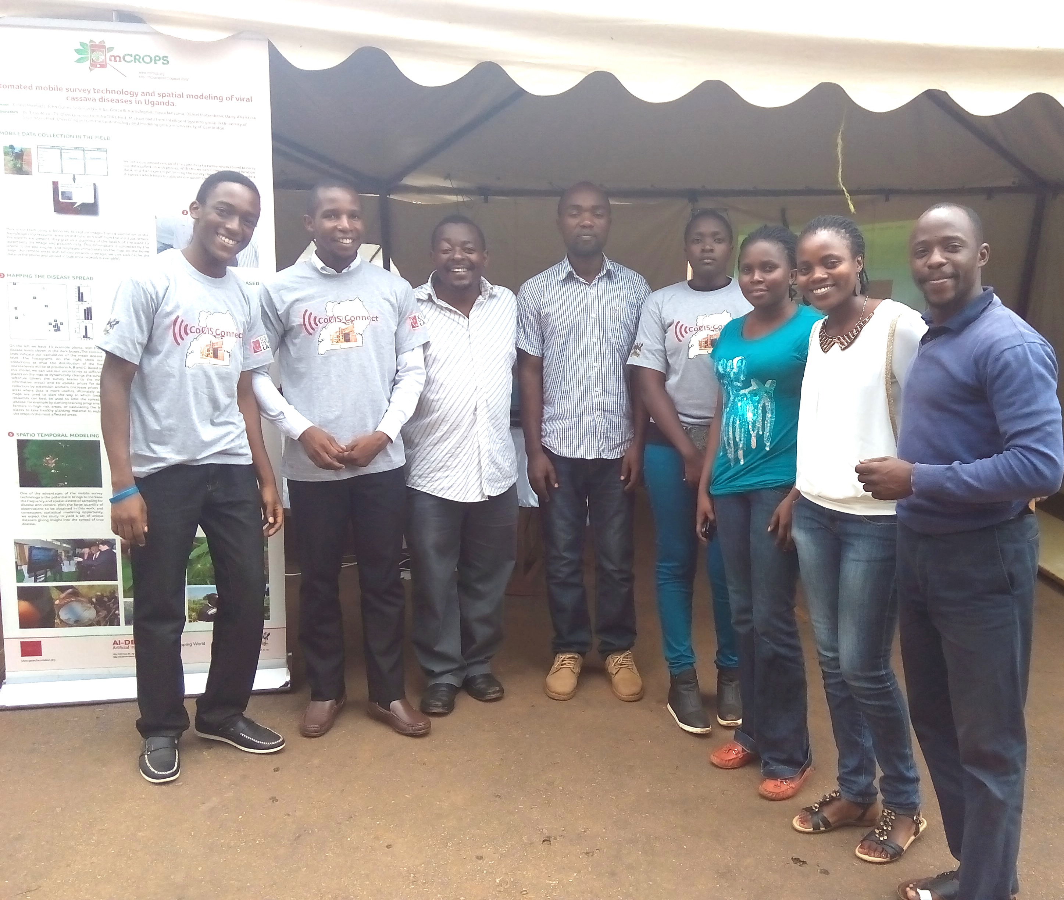
The mCROPS team

Slide 3
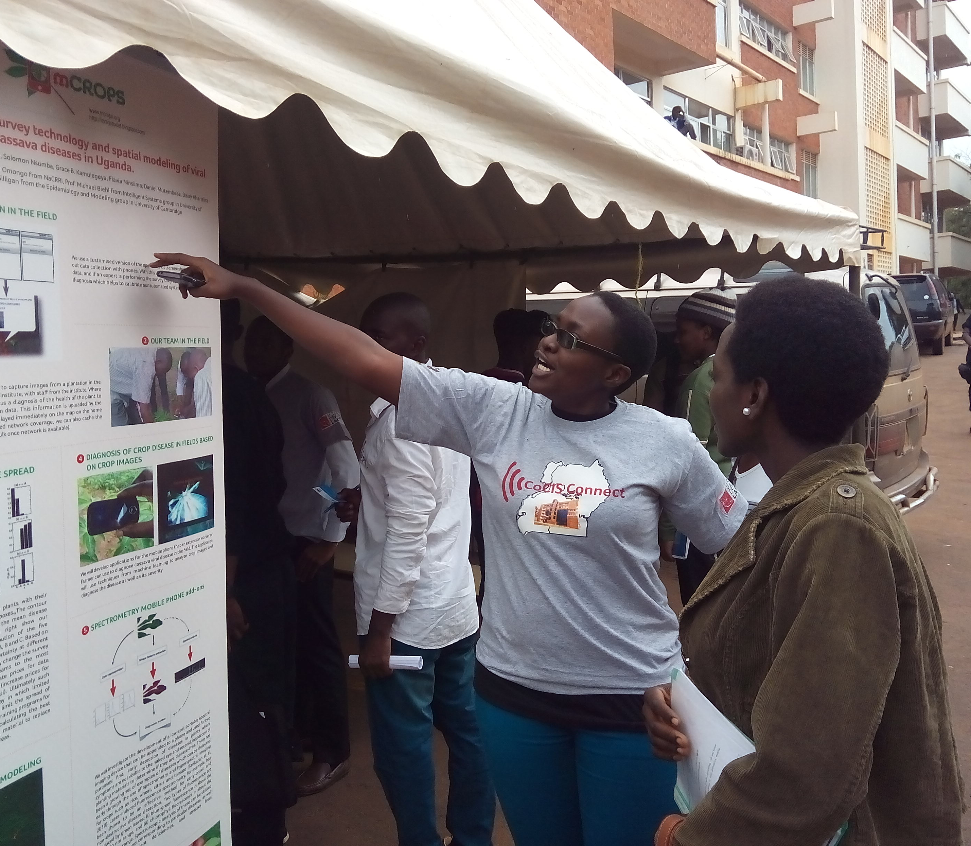
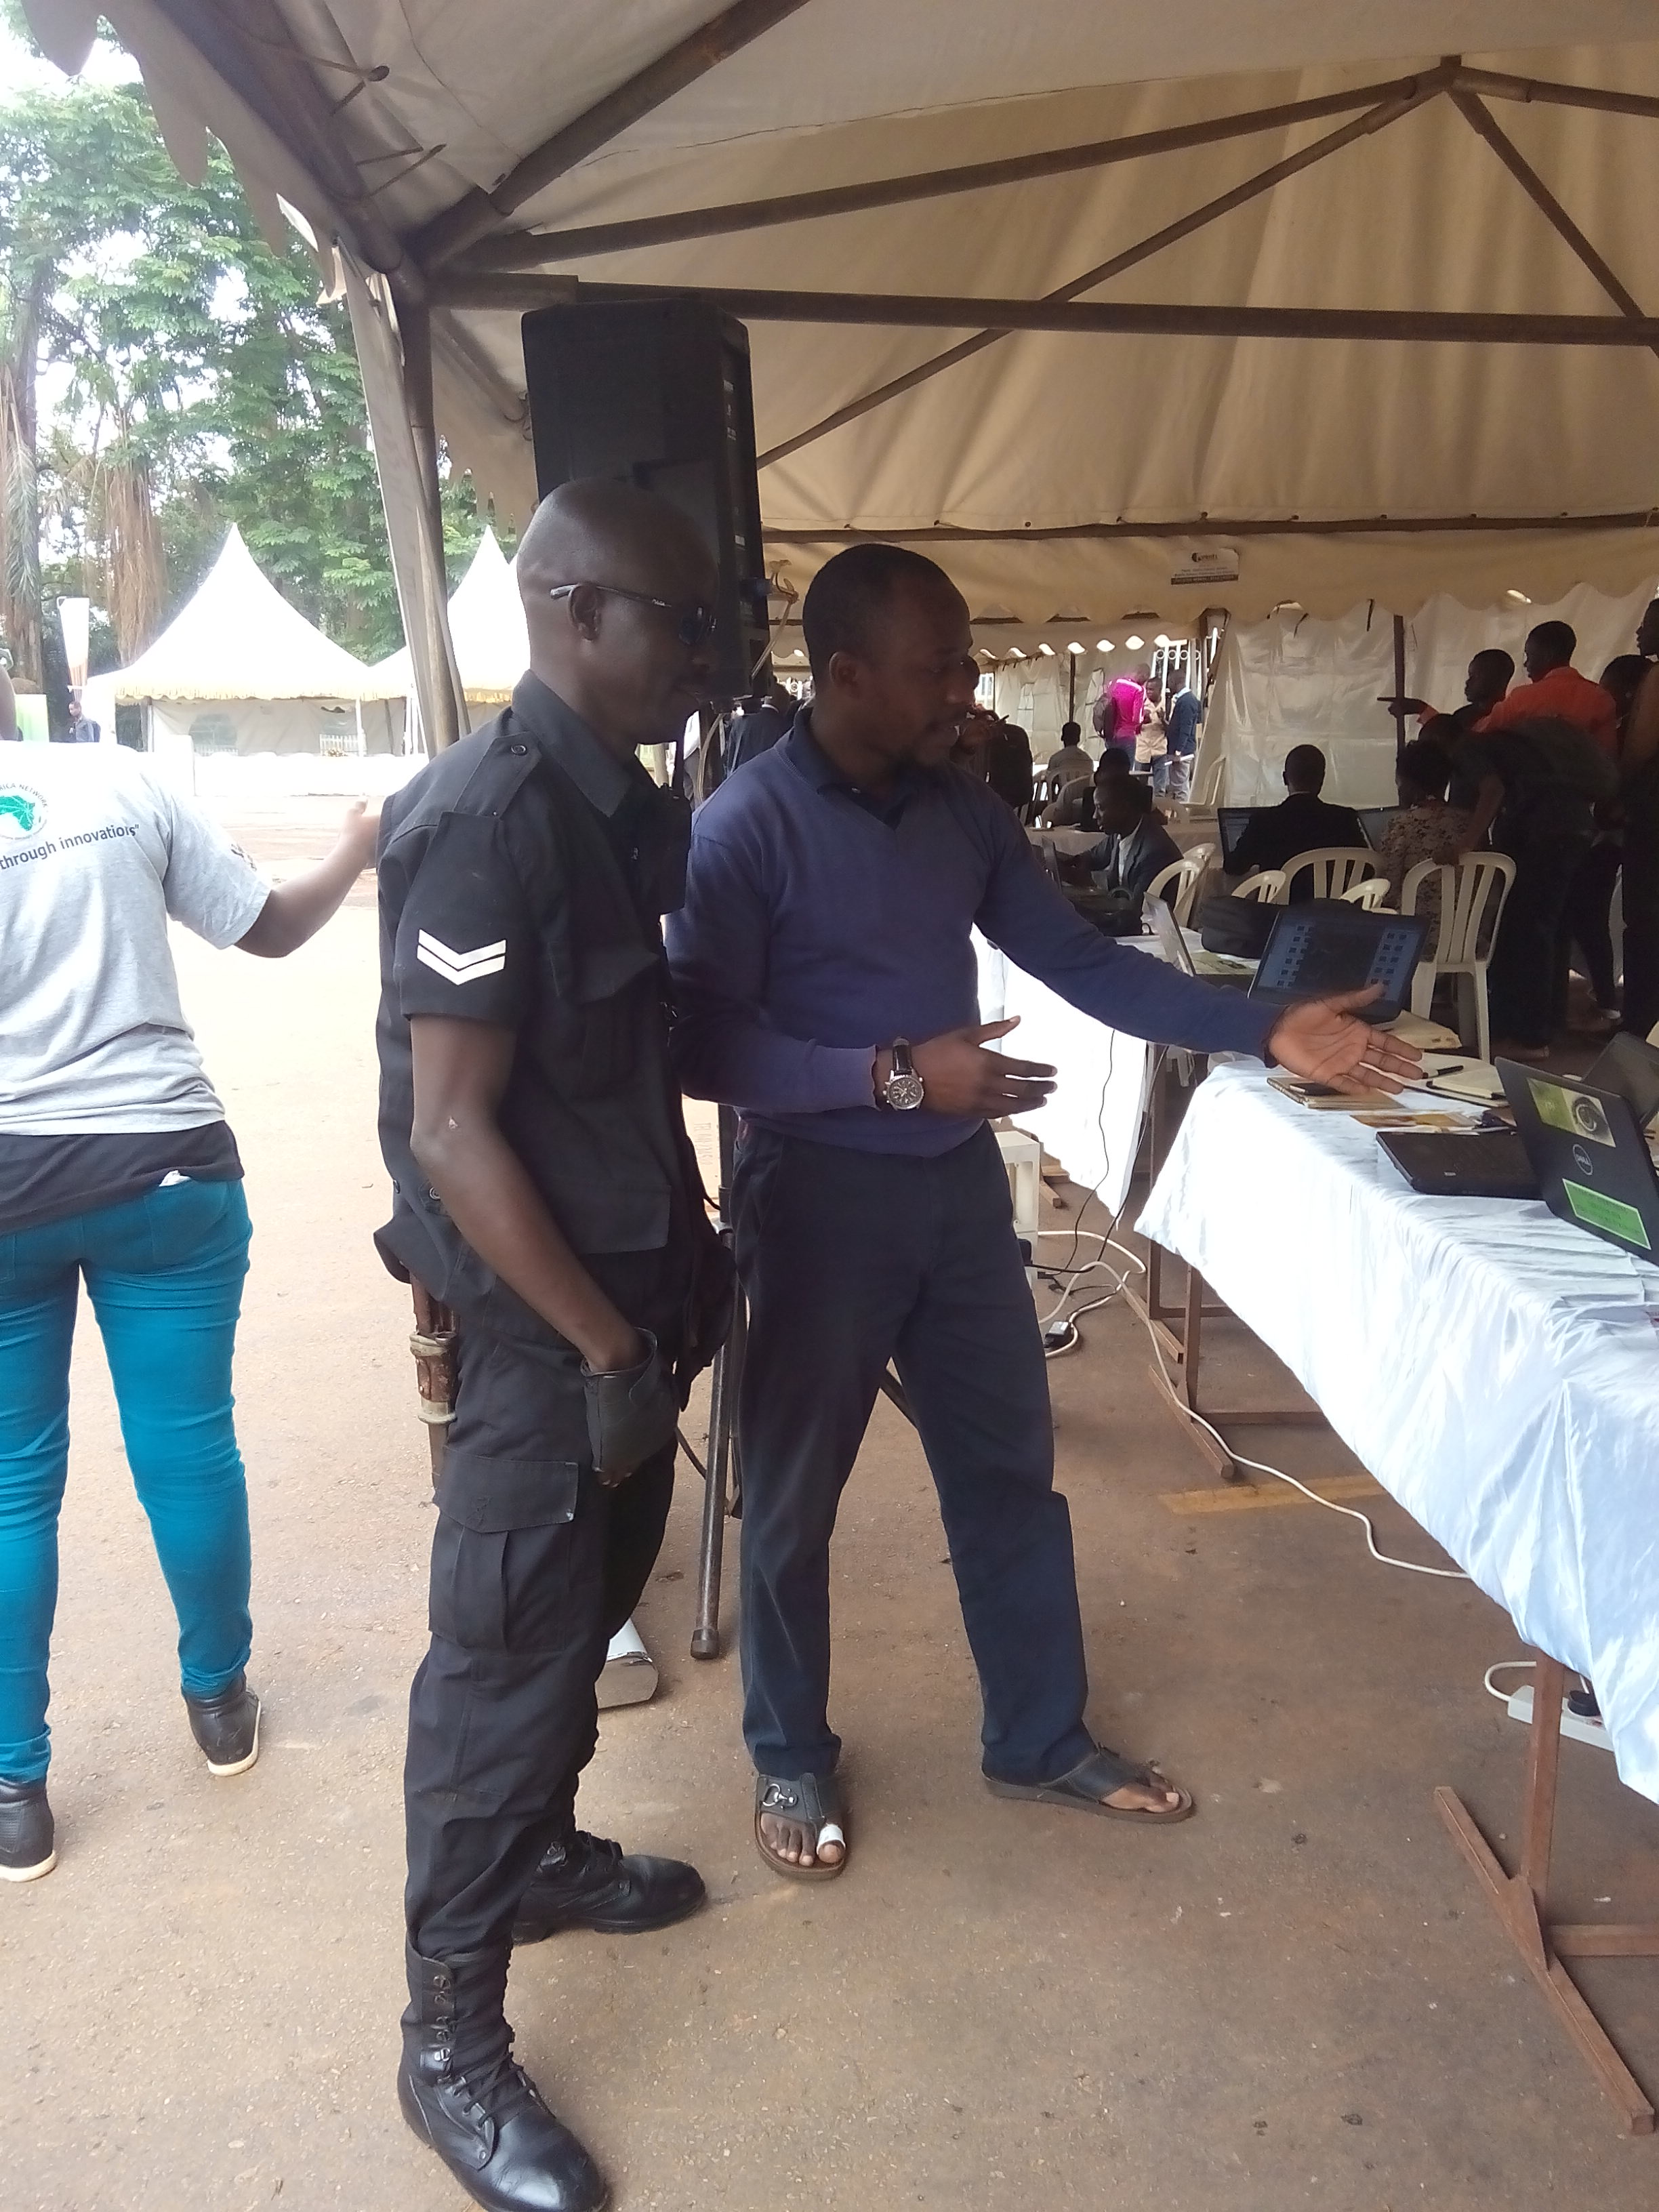

Slide 4
Uniqueness of image data
Ubiquity of mobile phones in developing countries means we can directly use the phones as a sensor.
With generally low levels of literacy and multiple languages in developing countries, (geo-coded) images form a universal data format.
People love to take images (the social angle)

Slide 5
Some case studies – in images

Slide 6
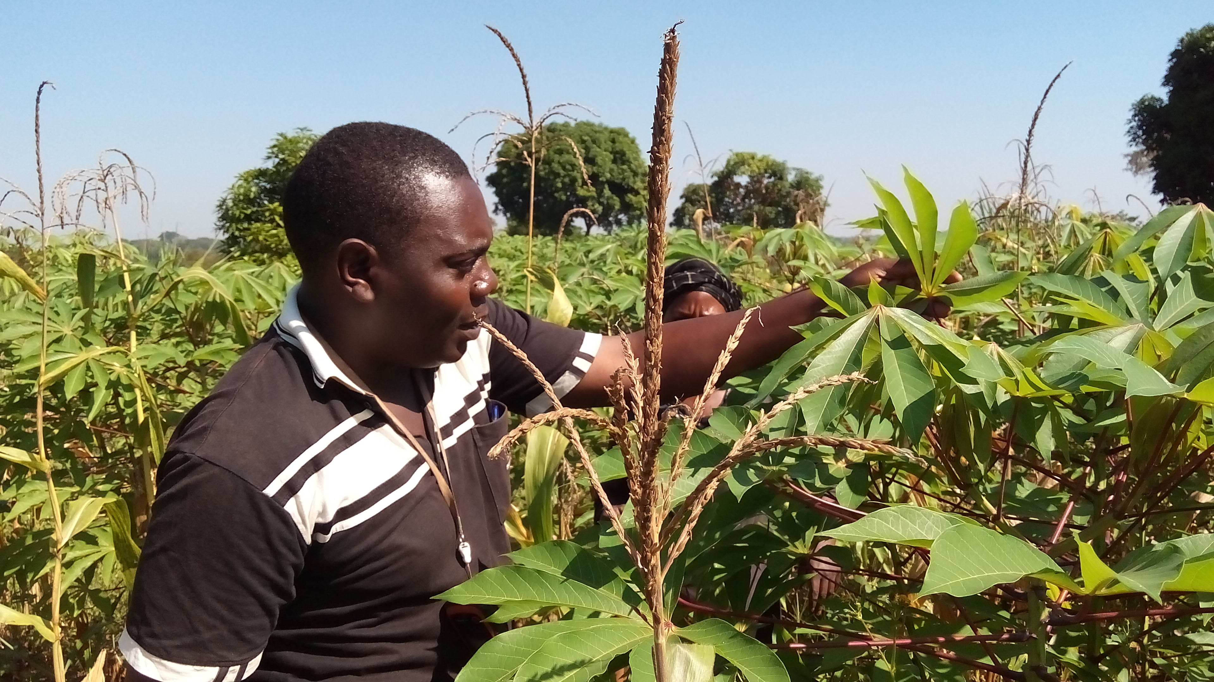
Challenges in disease surveillance Data Collection

Slide 7
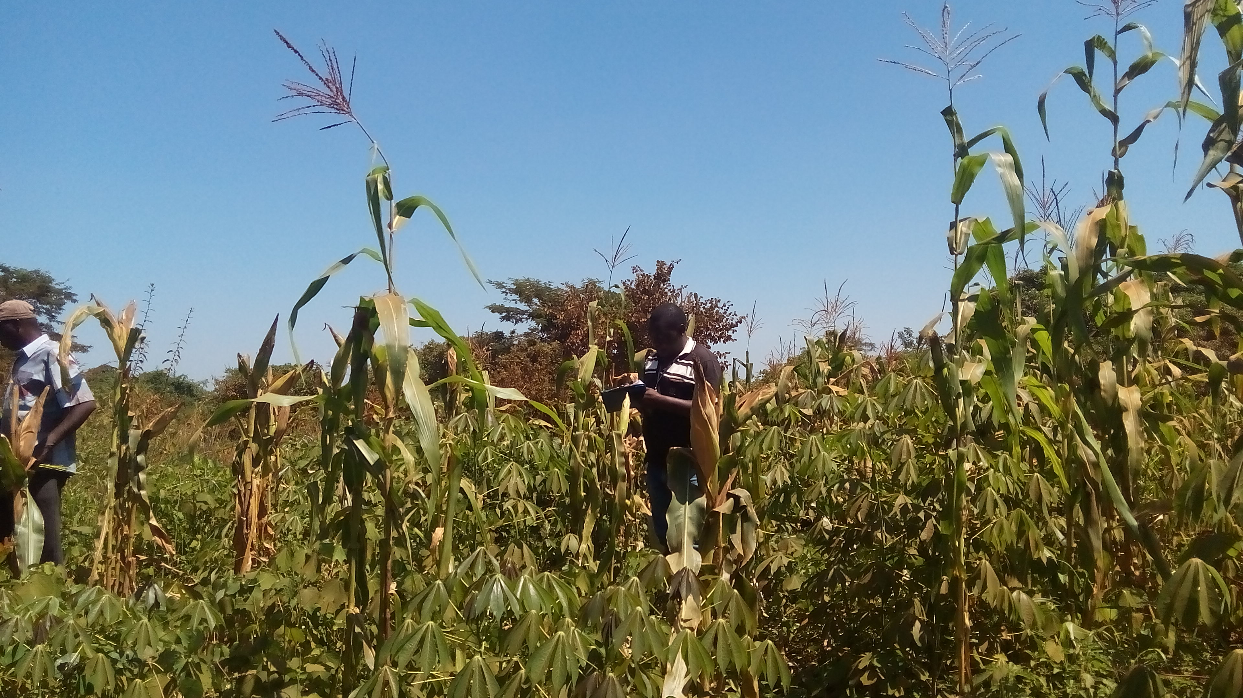
Paper-based – 6 months turn-around from raw data to surveillance map

Slide 8
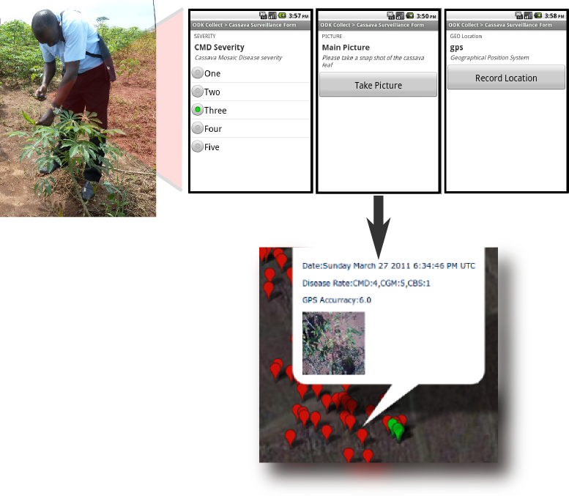
New (near real-time) ways of collecting data – new data sources, images

Slide 9
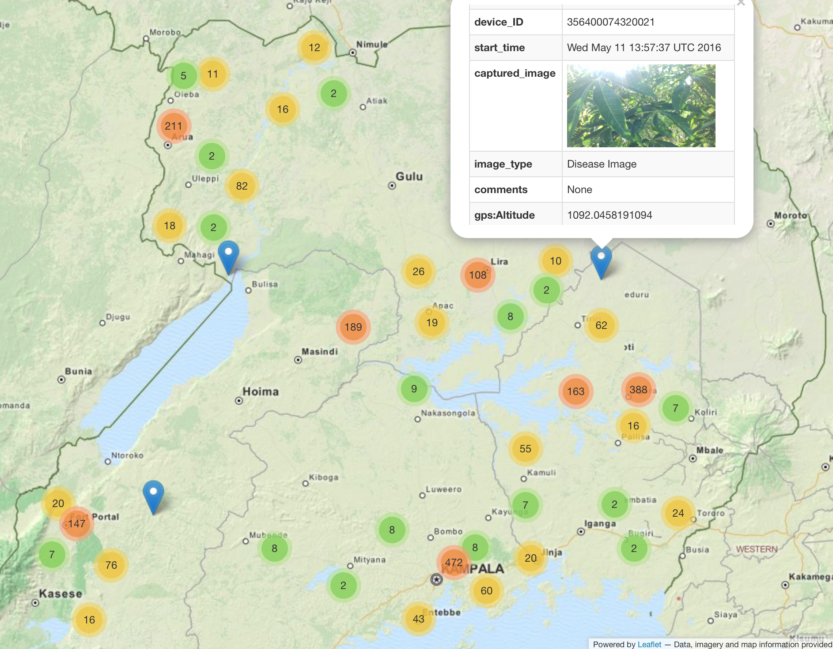
Adhoc Surveillance – real-time, all year round data collection

Slide 10
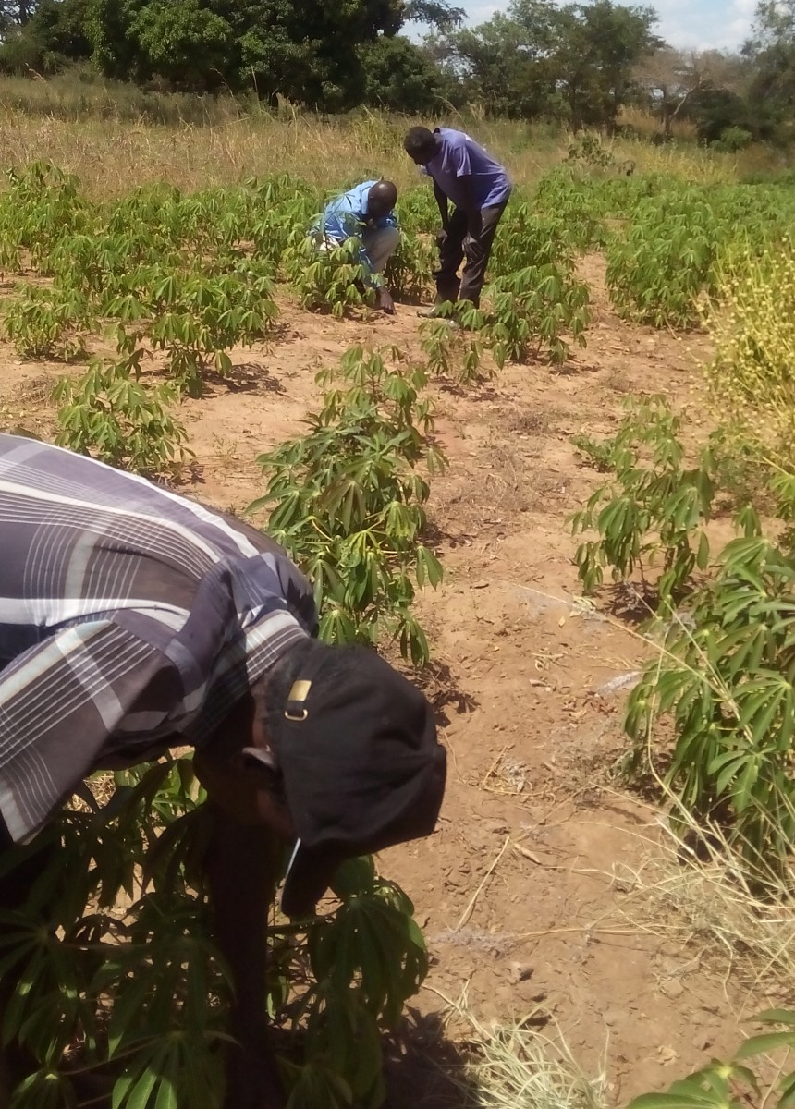
Challenges in Diagnosis – Resource intensive (experts, time & money)

Slide 11
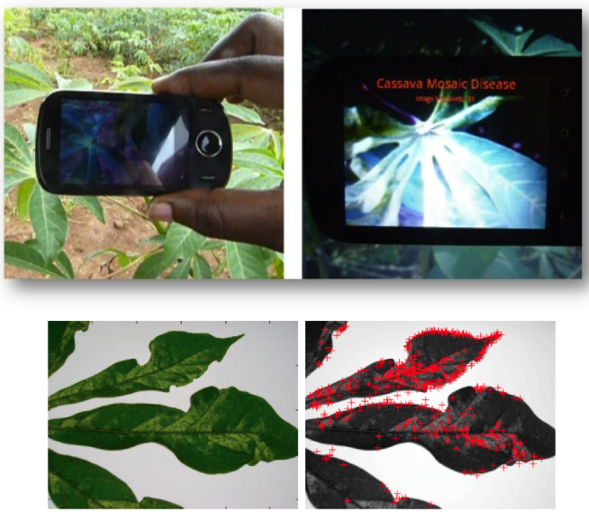
Smartphone-based diagnosis using leaf images

Slide 12
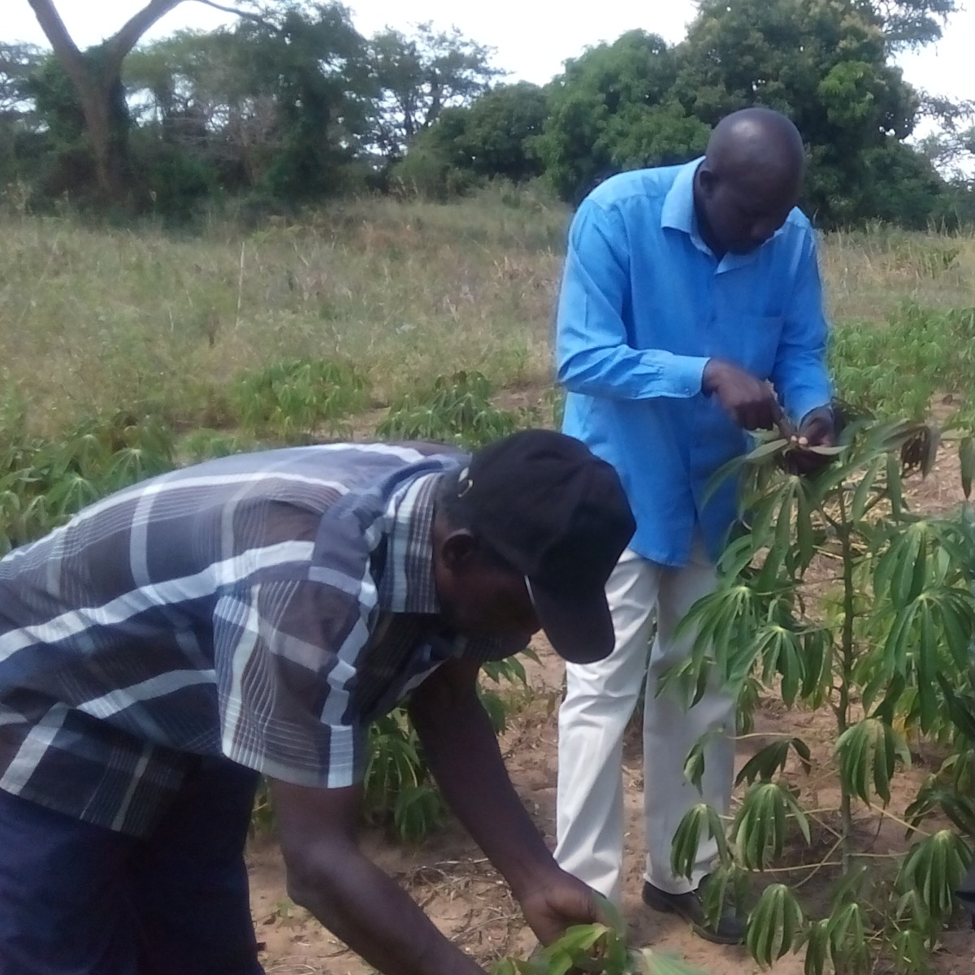
Challenges in pest and symptom assessment - manual, inaccurate & subjective

Slide 13
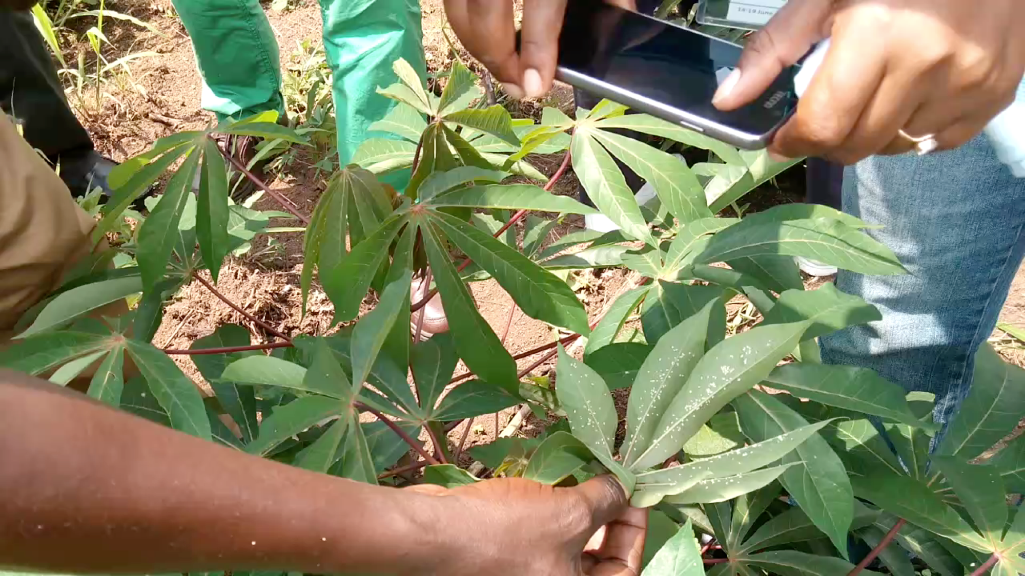
Field-based pest and symptom measurement

Slide 14
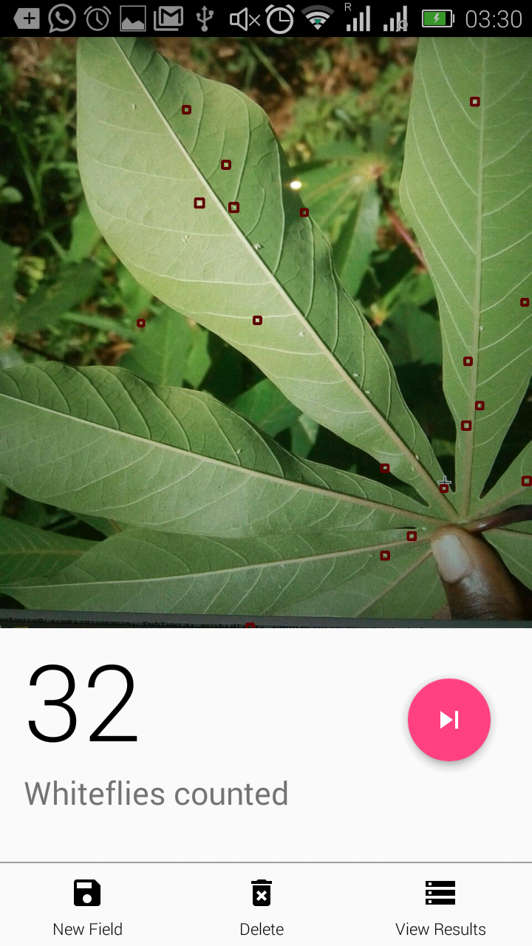
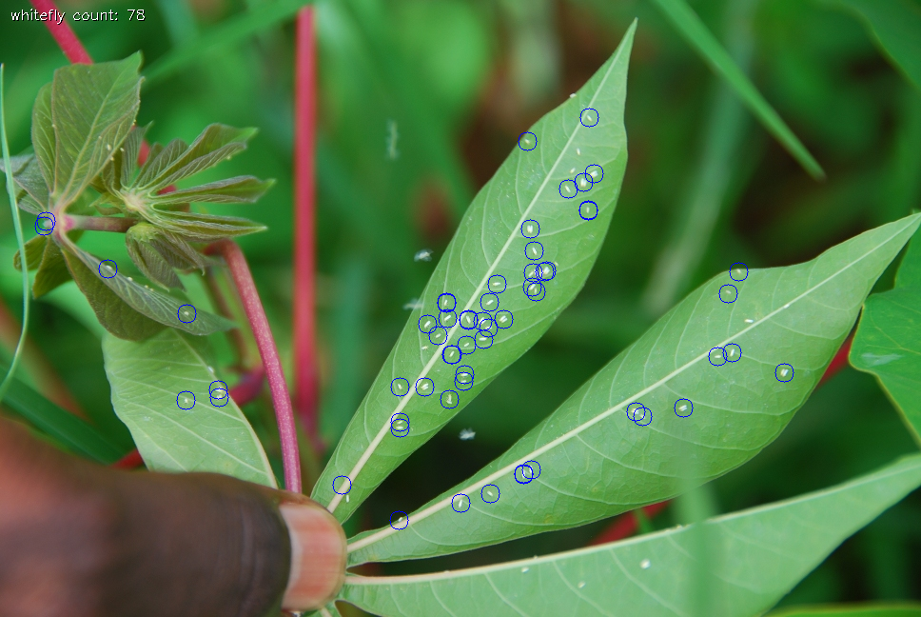
Automated whitefly count

Slide 15
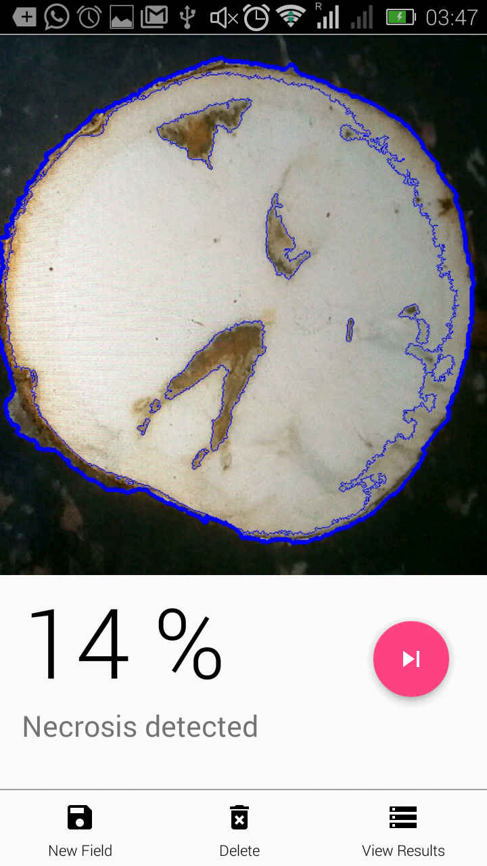
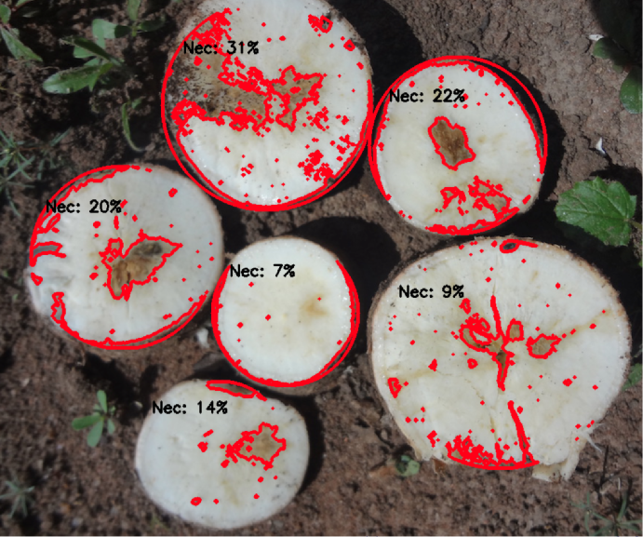
Symptom measurement

Slide 16
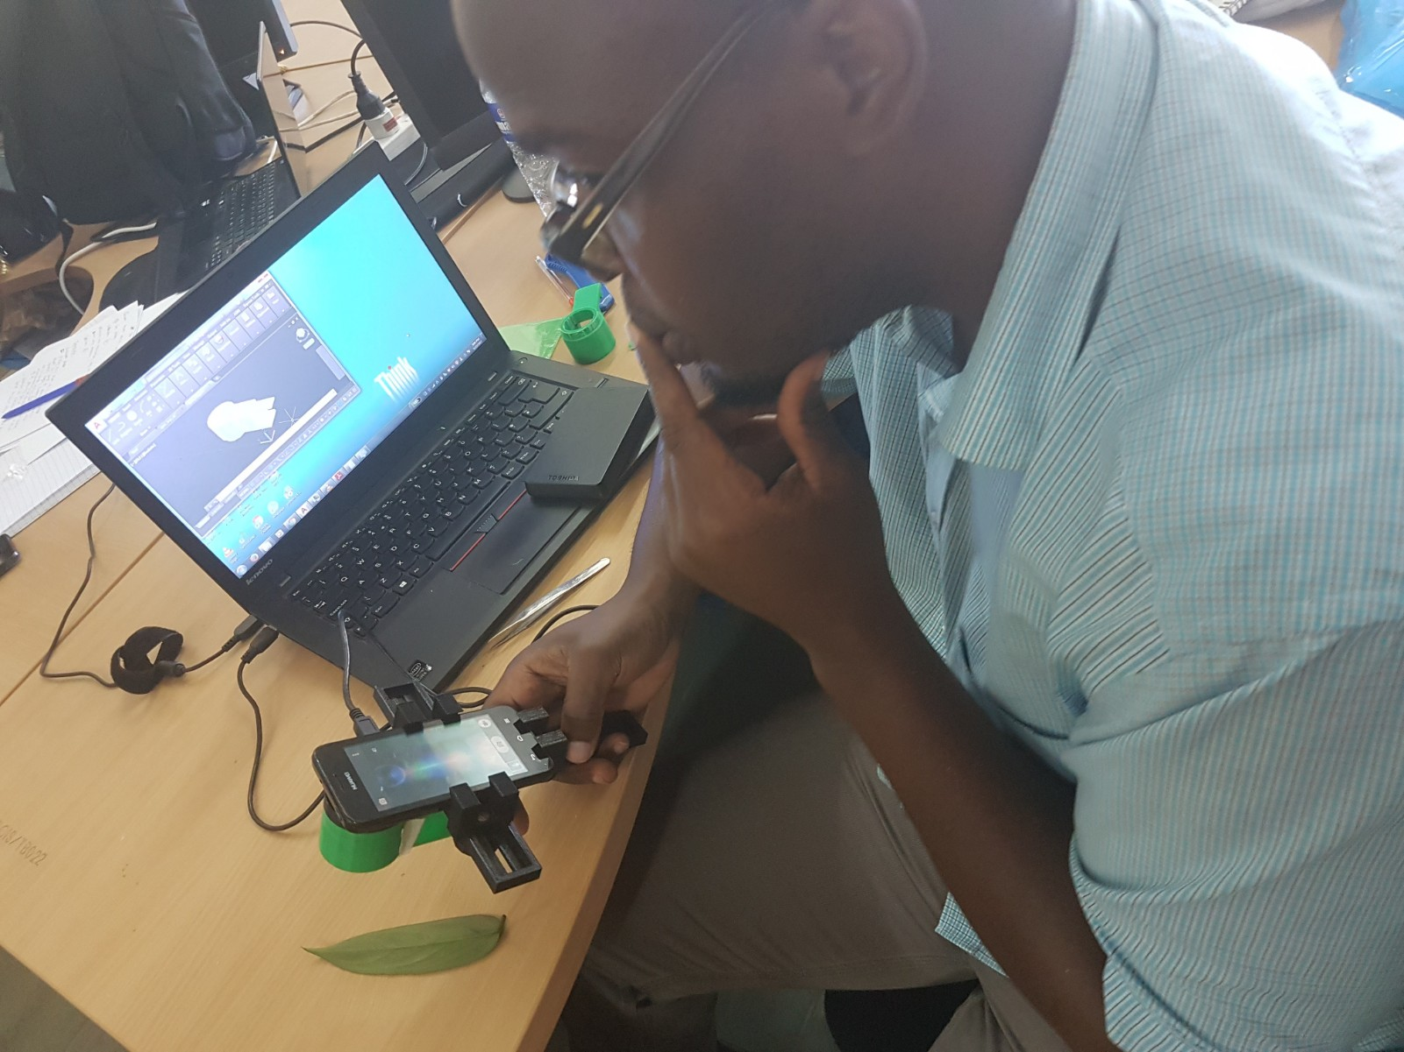
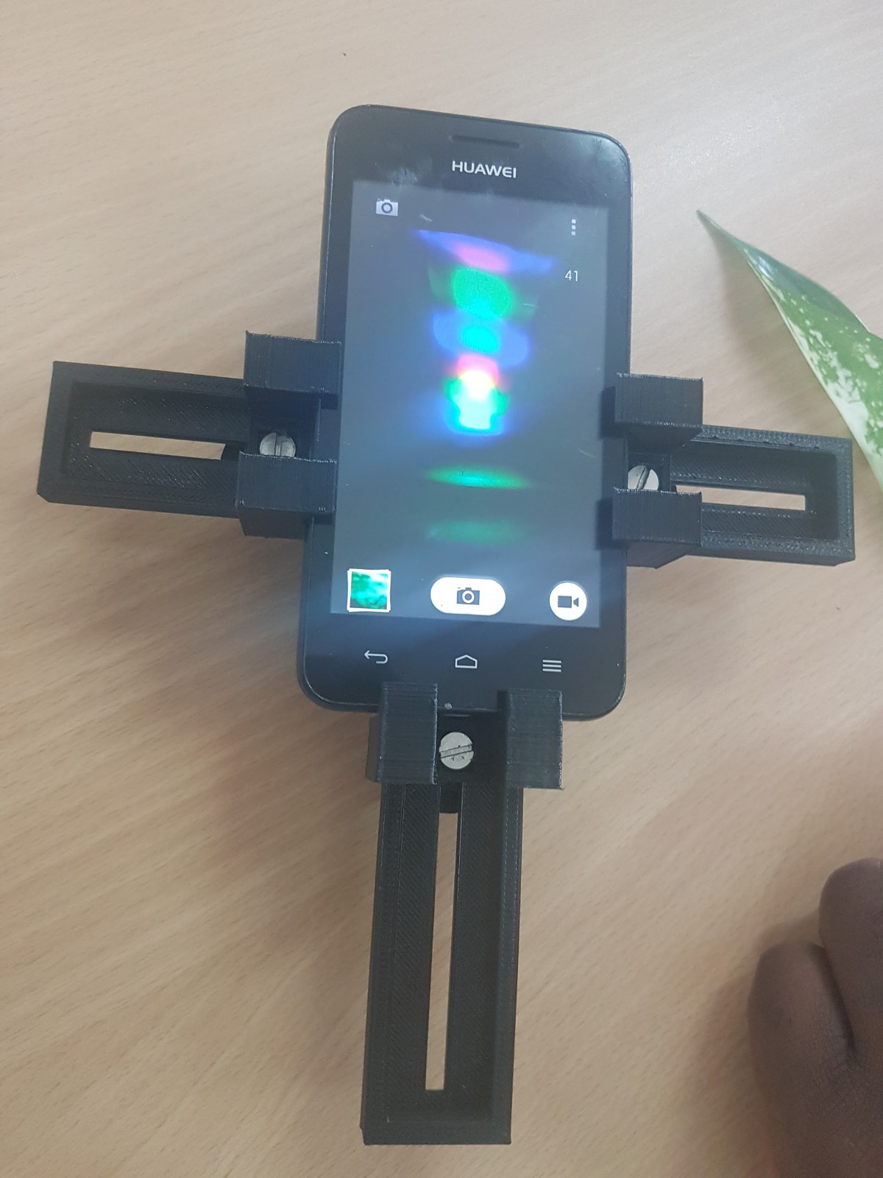
Low-cost spectrometry for disease diagnosis:
3D printed smartphone add-on

Slide 17

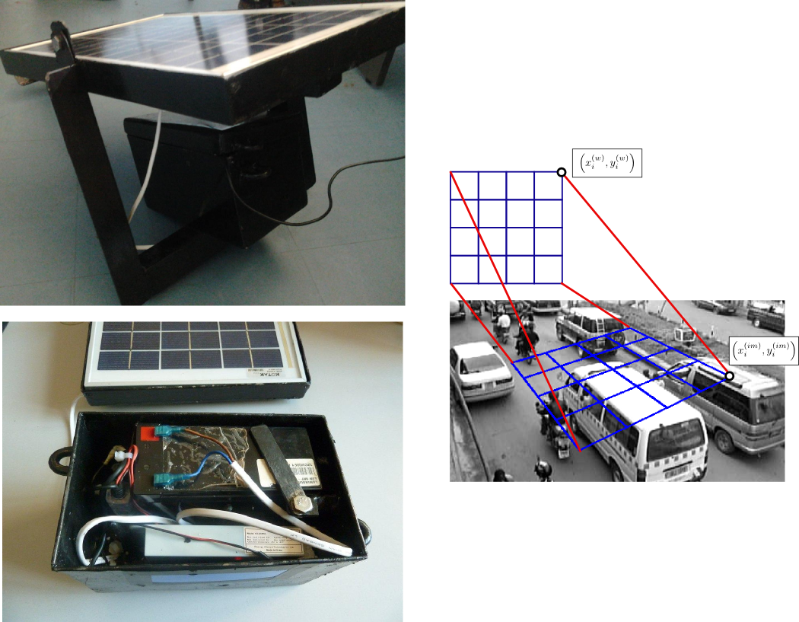
Traffic monitoring from images taken from a smartphone

Slide 18
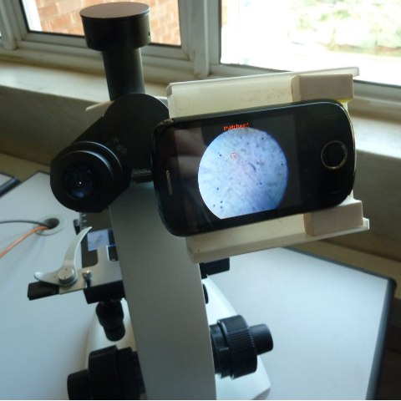
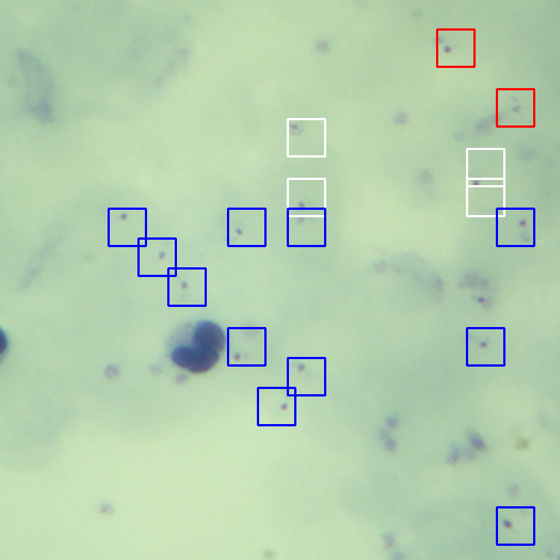
Malaria microscopy:
Inference from images of blood slides

Slide 19
Considerations
Image quality – system vs user control.
Image size and transmission over network.
Image storage and analysis
Privacy

Slide 20
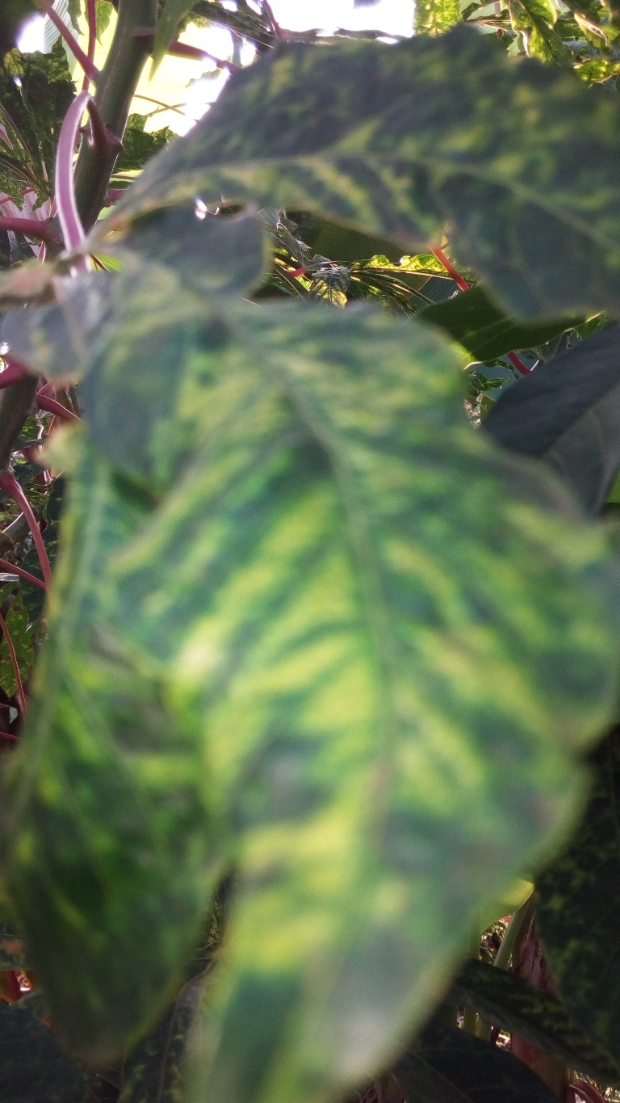
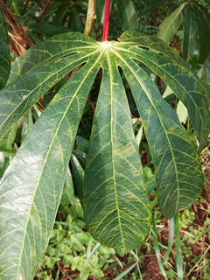
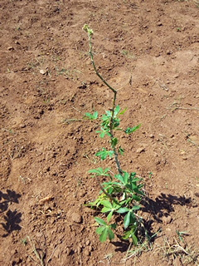
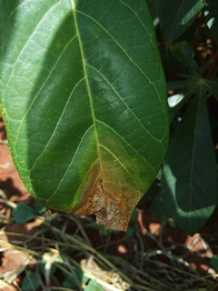
Considerations
Image quality – system vs user control.
Image size and transmission over network.
Image storage and analysis
Privacy

Slide 21
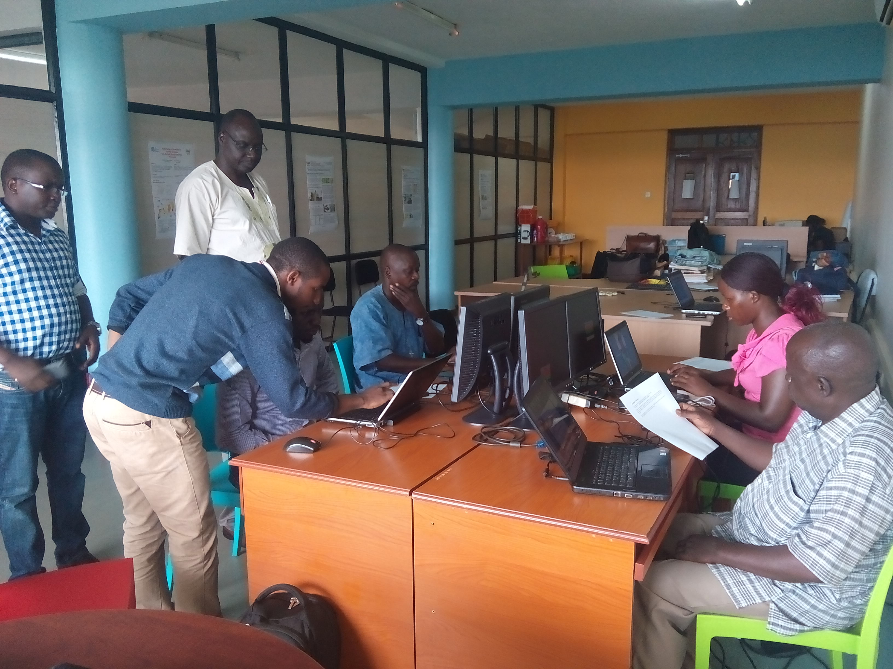
Collaboration & Stakeholder involvement – KEY !

Slide 22
Acknowledgements:
Bill and Melinda Gates Foundation
National Agricultural Research Organization (NARO – Uganda)
Pulse Lab Uganda
Other partner organizations/universities

Slide 23
Thank You !

